Slide 1
Data-Driven Discovery of Governance Equation!
xxy1101@mail.ustc.edu.cn

Slide 2
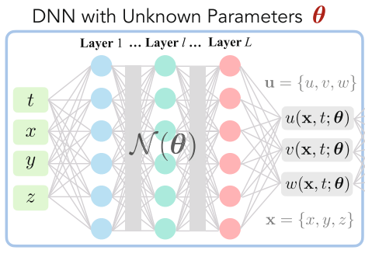
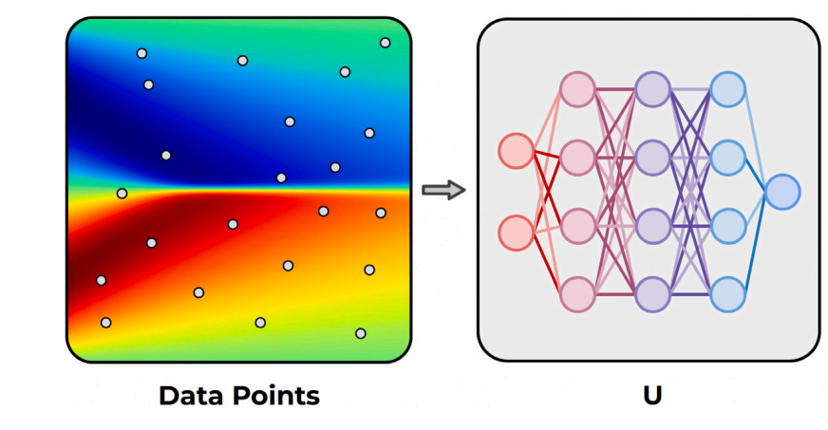
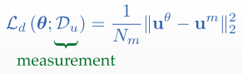
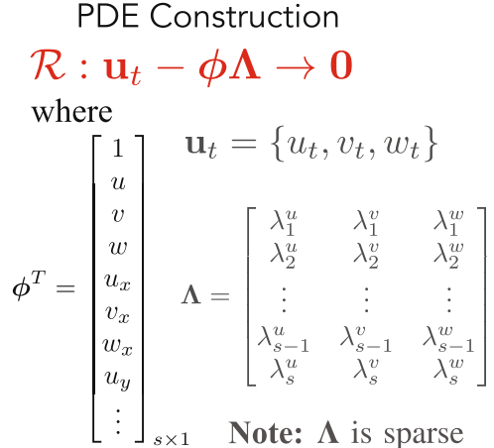
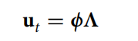
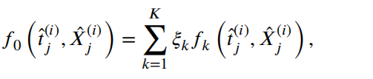
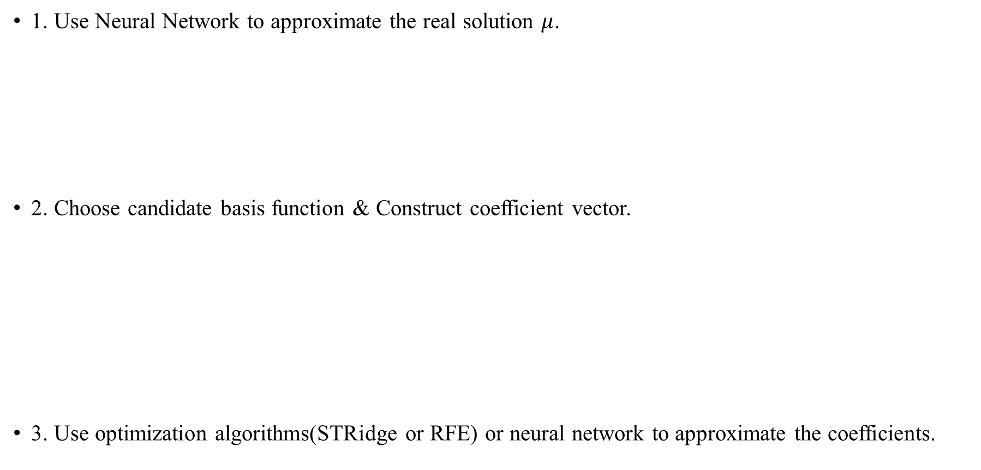
Data-Driven Pipeline
1. Use Neural Network to approximate the real solution $μ$.
2. Choose candidate basis function & Construct coefficient vector.
3. Use optimization algorithms(STRidge or RFE) or neural network to approximate the coefficients.

Slide 3
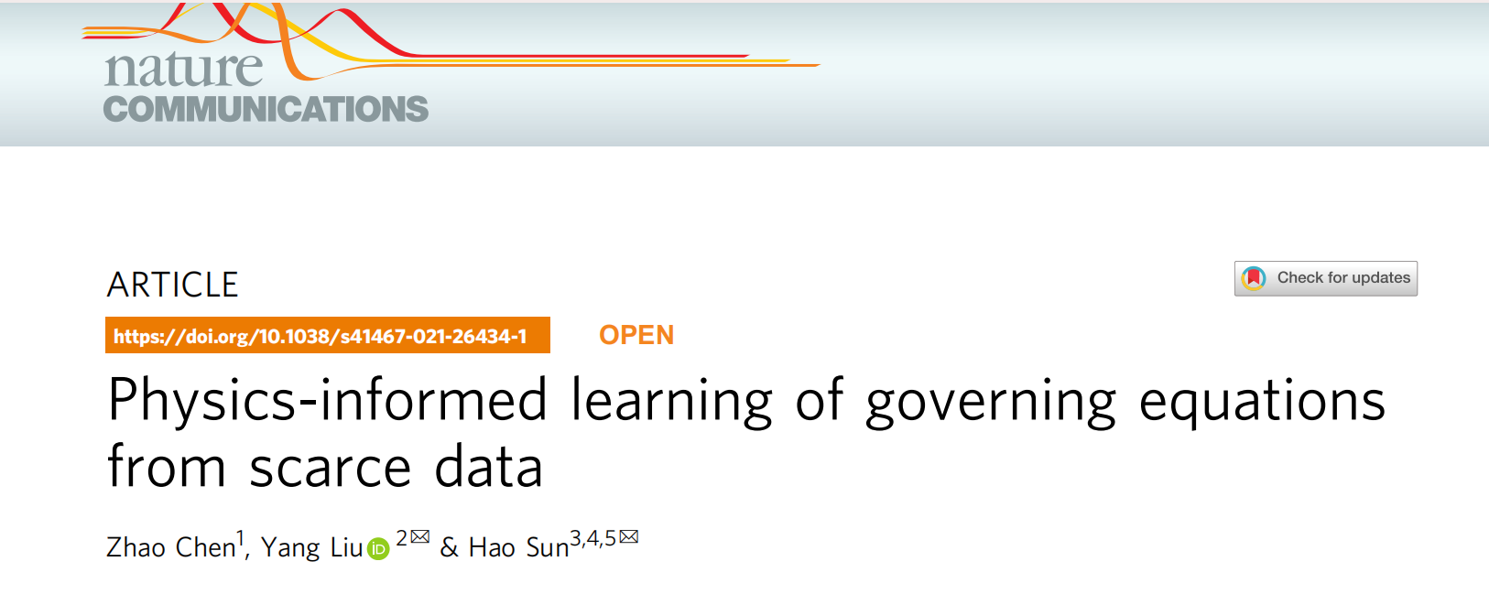
Physics-informed learning of governing equations from scarce data

Slide 4
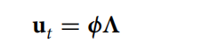
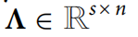
Basic Setting
A set of nonlinear, coupled, parameterized PDEs in the general form:
Assume that the physical law is governed by only a few important terms which can be selected from a large-space library of candidate functions:
Datasets:
(1) one dataset from a single I/BC
(2) r ≥ 2 independent datasets from multiple I/BCs.

Slide 5
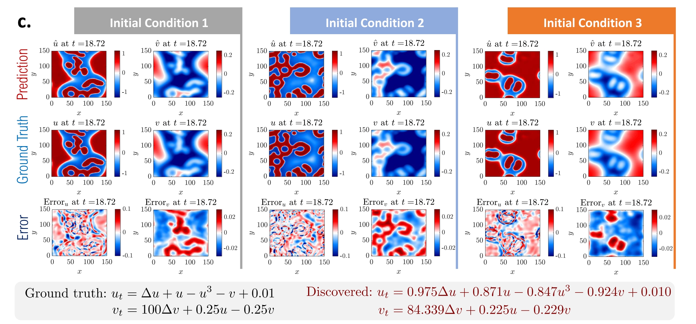
Basic Setting
The same PDE with different ICs!

Slide 6
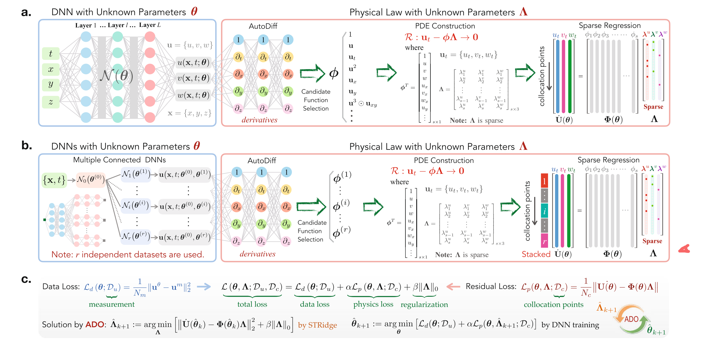
Physics-informed learning of governing equations from scarce data
t,x,y,z,u(t,x,y,z)
Lp=|u_t -三角 \times library|；（u_t,v,w)

Slide 7
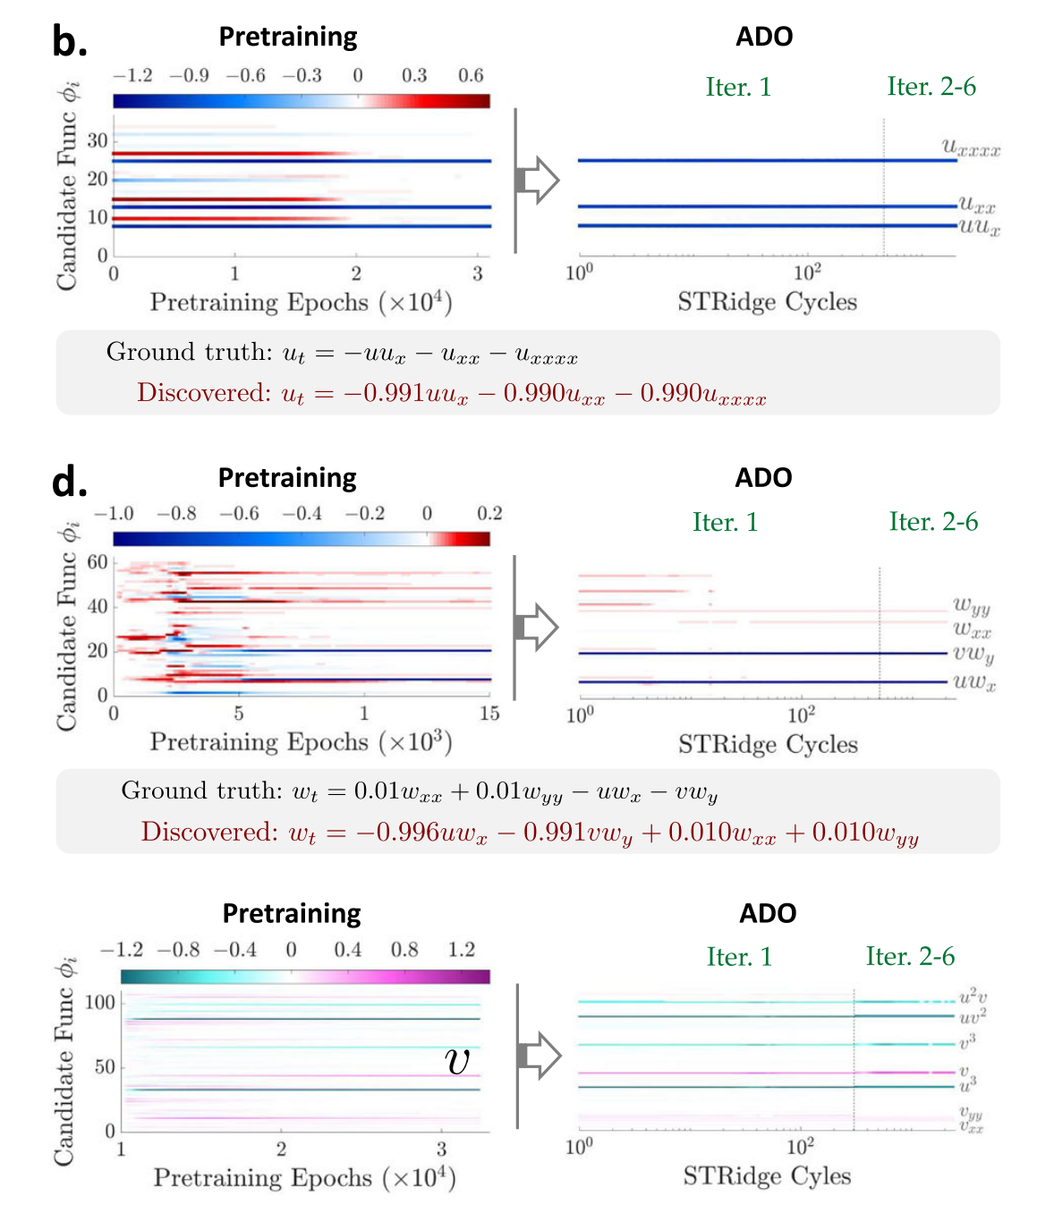
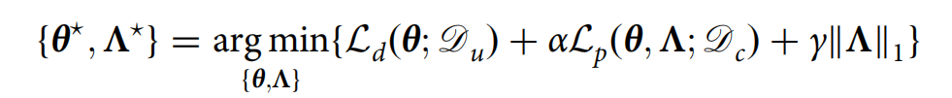
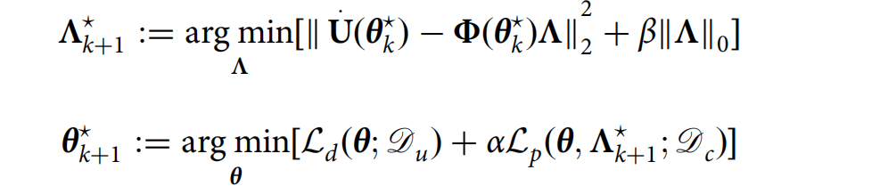
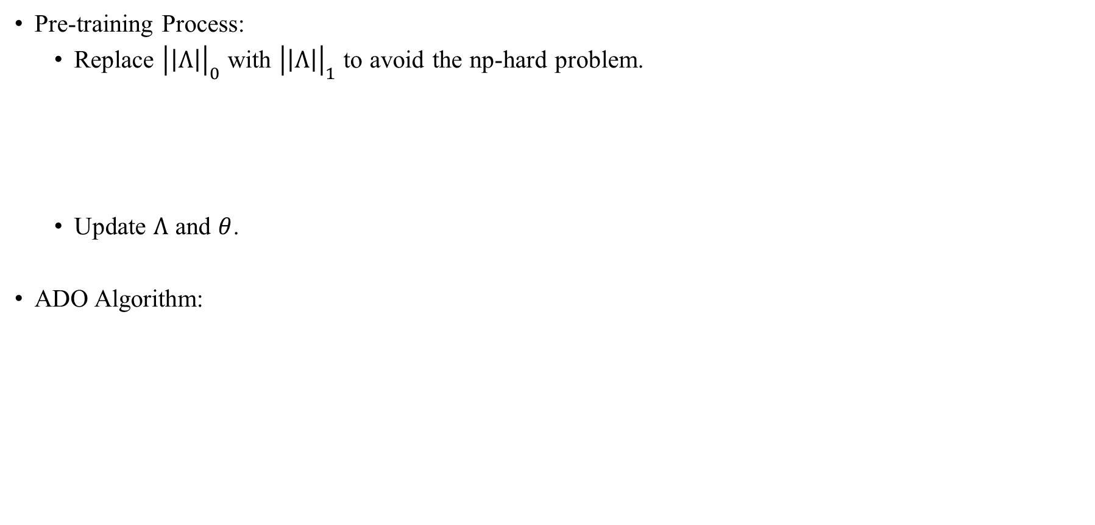
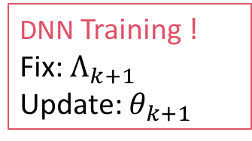
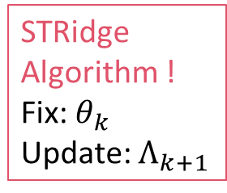
Training Details
Pre-training Process:
Replace ${\left|\left|Λ\right|\right|}_{0}$ with ${\left|\left|Λ\right|\right|}_{1}$ to avoid the np-hard problem.
Update $Λ$ and $θ$.
ADO Algorithm:
STRidge Algorithm !
Fix: $θ_{k}$
Update: $Λ_{k+1}$
DNN Training !
Fix: $Λ_{k+1}$
Update: $θ_{k+1}$

Slide 8
Codes
用tensorflow1.15-gpu写的：
Plan A：装了tensorflow1.15-gpu开始训练，发现和驱动不兼容，导致代码gpu失败。
Plan B：装了tensorflow2.0+，发现代码报错巨多，更改难度堪比直接用torch重写。
使用脚本重写；
Plan C：用cpu训练（current）

Slide 9
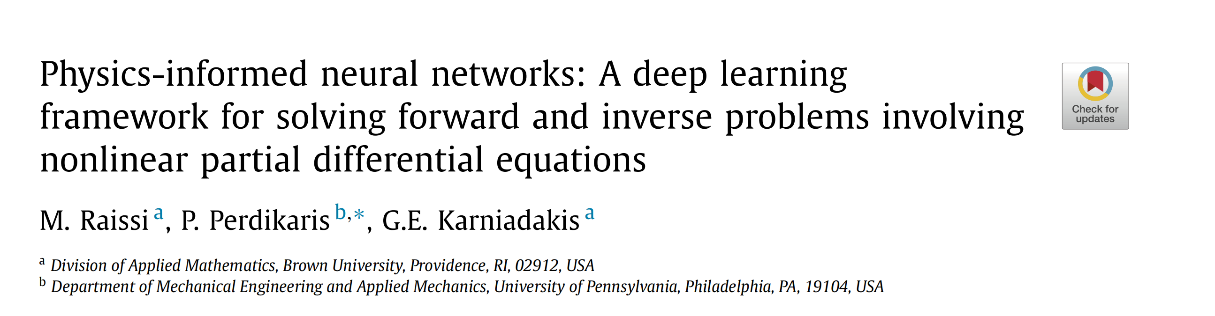
Physics-informed neural networks

Slide 10
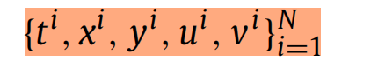
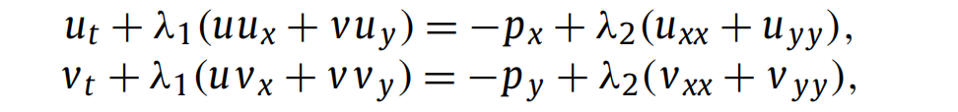
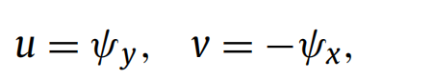
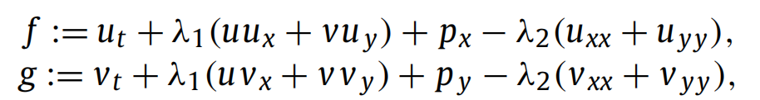
Basic Setting
Given noisy measurements:
Equation:
Goal:
Learning the parameters λ as well as the pressure p(t, x, y).
Method:
Make assumption on variables:
Discrete the known equation form:
The equation form is already known!
Avoid the basis function!

Slide 11
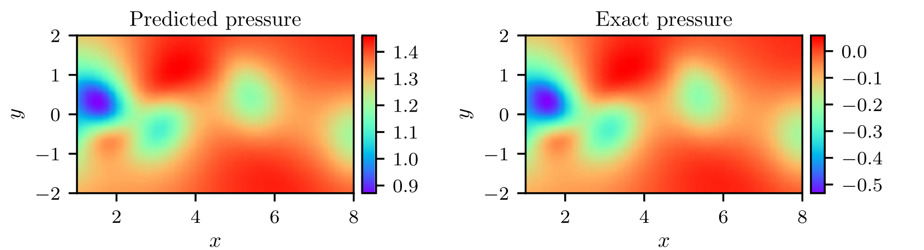
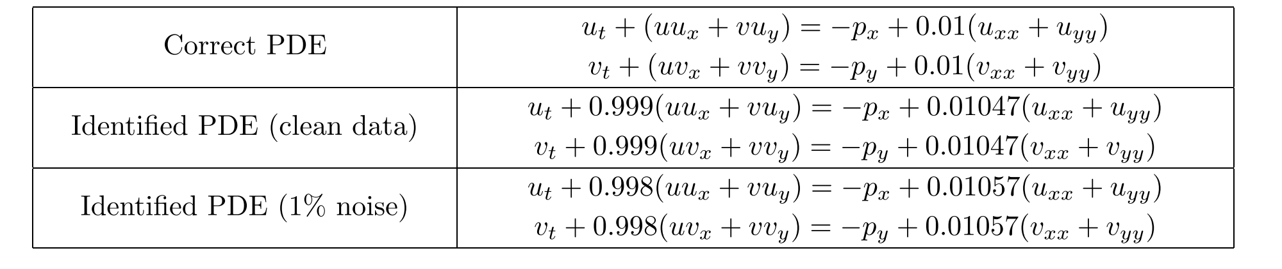
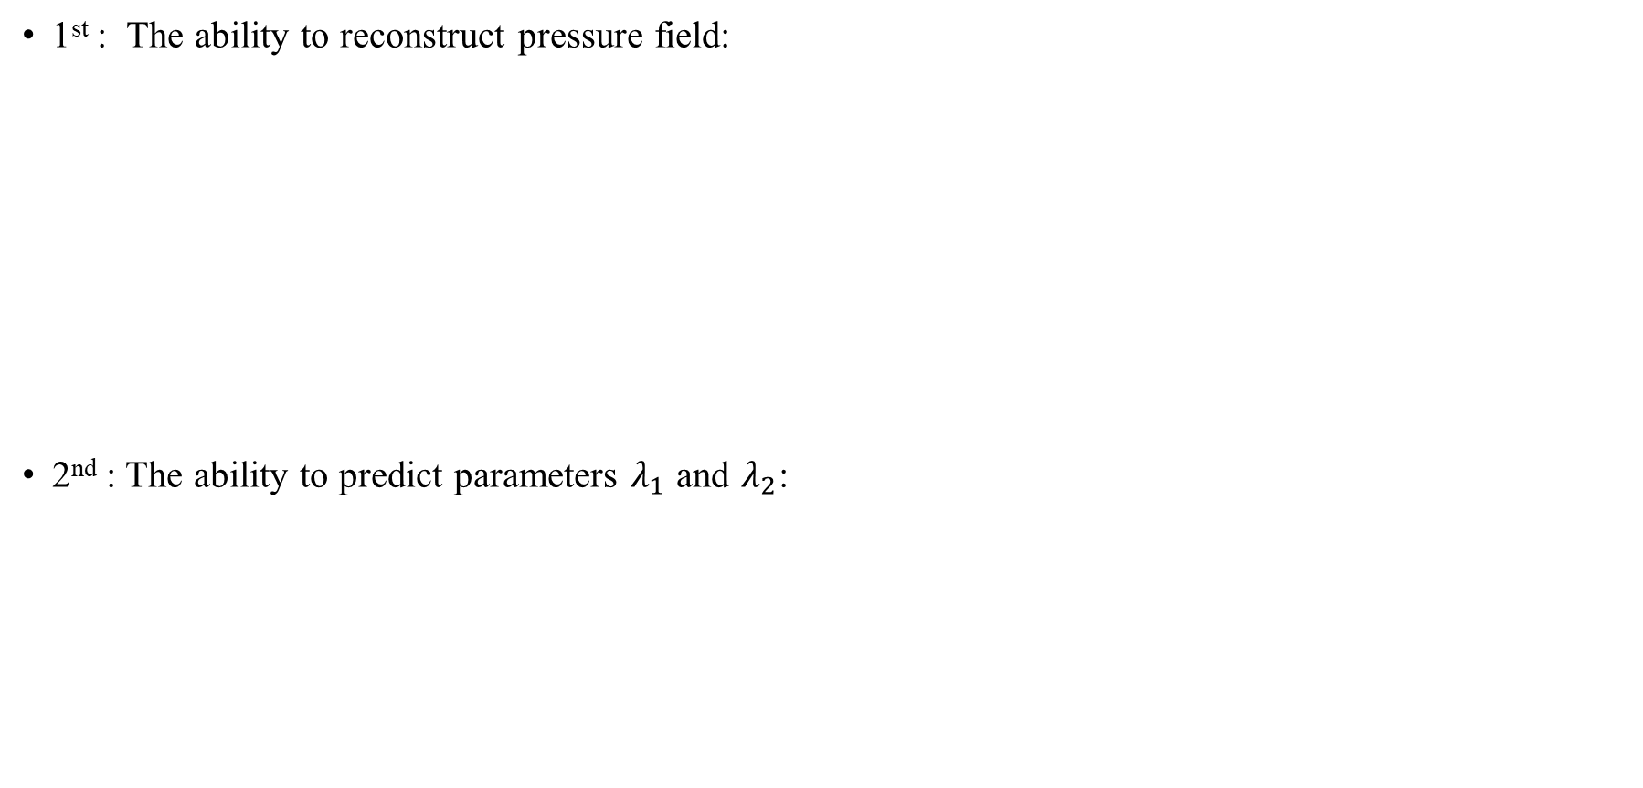
Results
1st : The ability to reconstruct pressure field:
2nd : The ability to predict parameters $λ_{1}$ and $λ_{2}$:

Slide 12
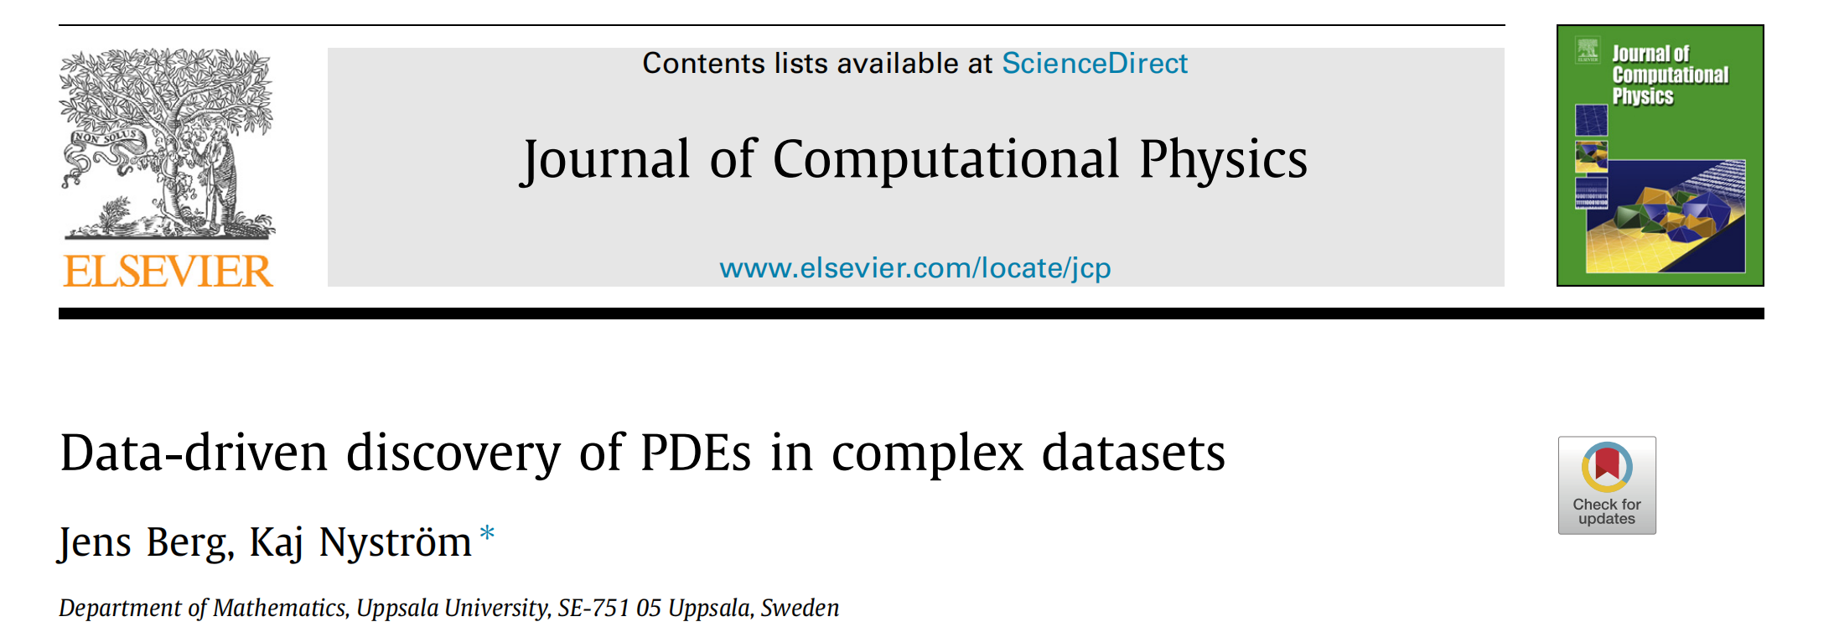
Data-driven discovery of PDEs in complex datasets

Slide 13
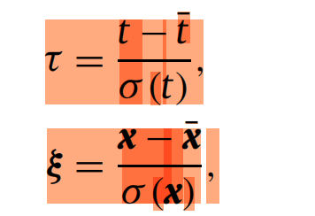
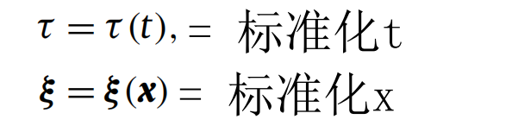
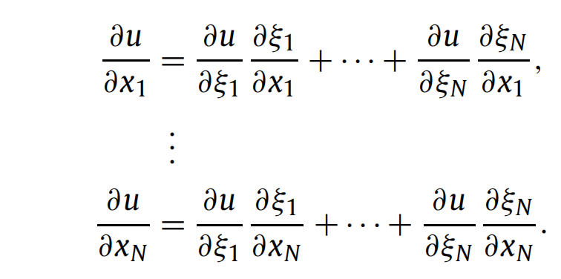
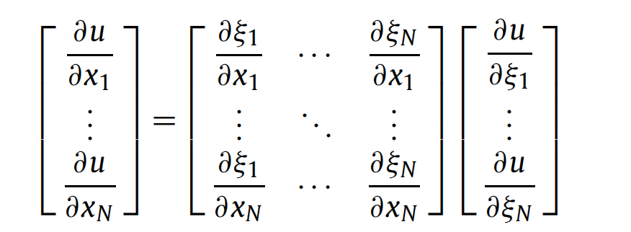
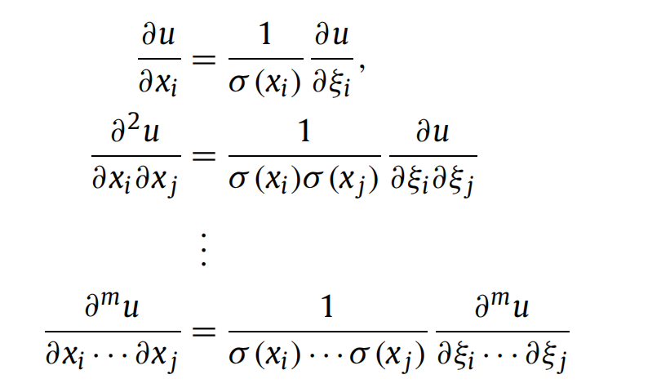
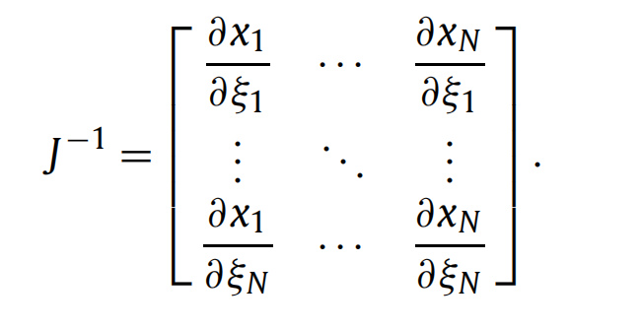
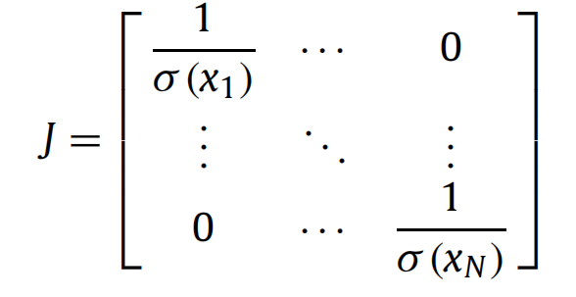
Method - Feature scaling
Whole: Feature scaling (data pre-processing) + Training
Using a neural network to approximate the dataset as a separate preprocessing step usually follows a pipeline in which feature scaling is included.
Jacobian matrix

Slide 14
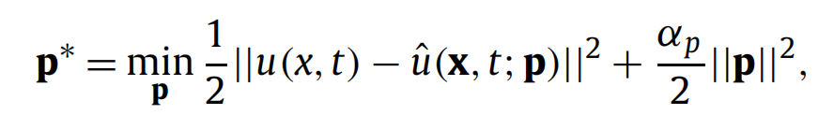
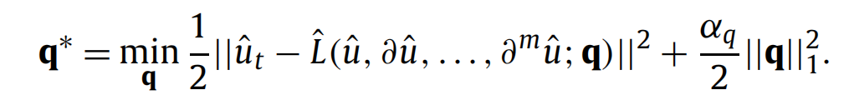
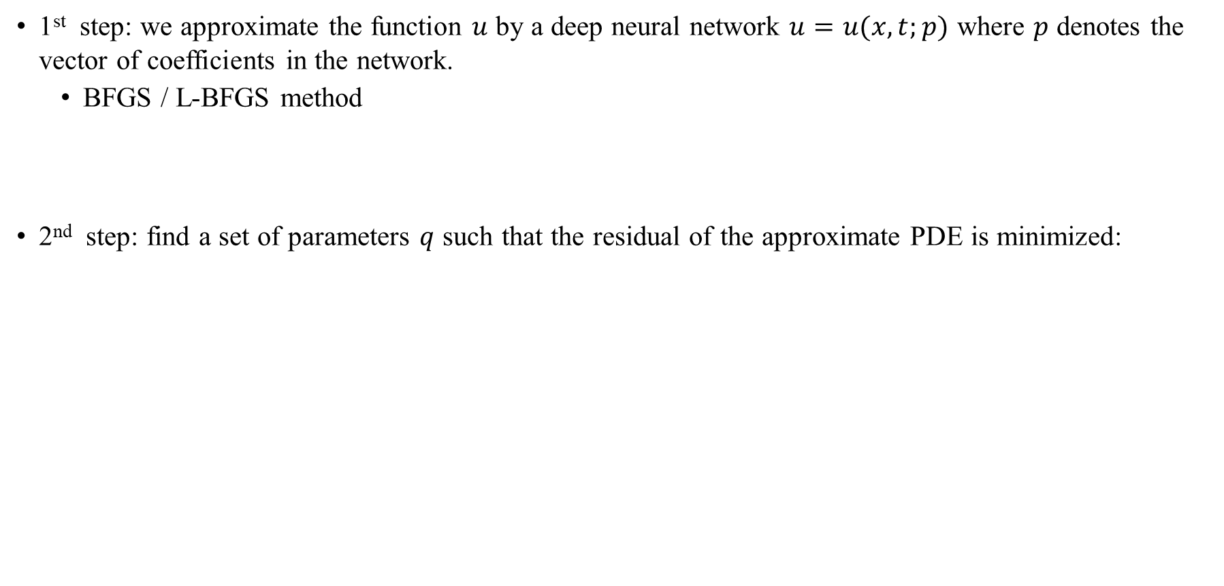
Method – Training (Common!)
1st step: we approximate the function $u$ by a deep neural network $u=u(x,t;p)$ where $p$ denotes the vector of coefficients in the network.
BFGS / L-BFGS method
2nd step: find a set of parameters $q$ such that the residual of the approximate PDE is minimized:
favor sparsity

Slide 15
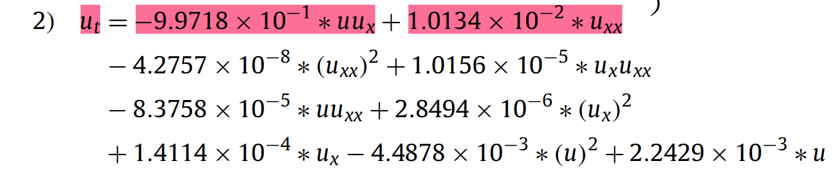
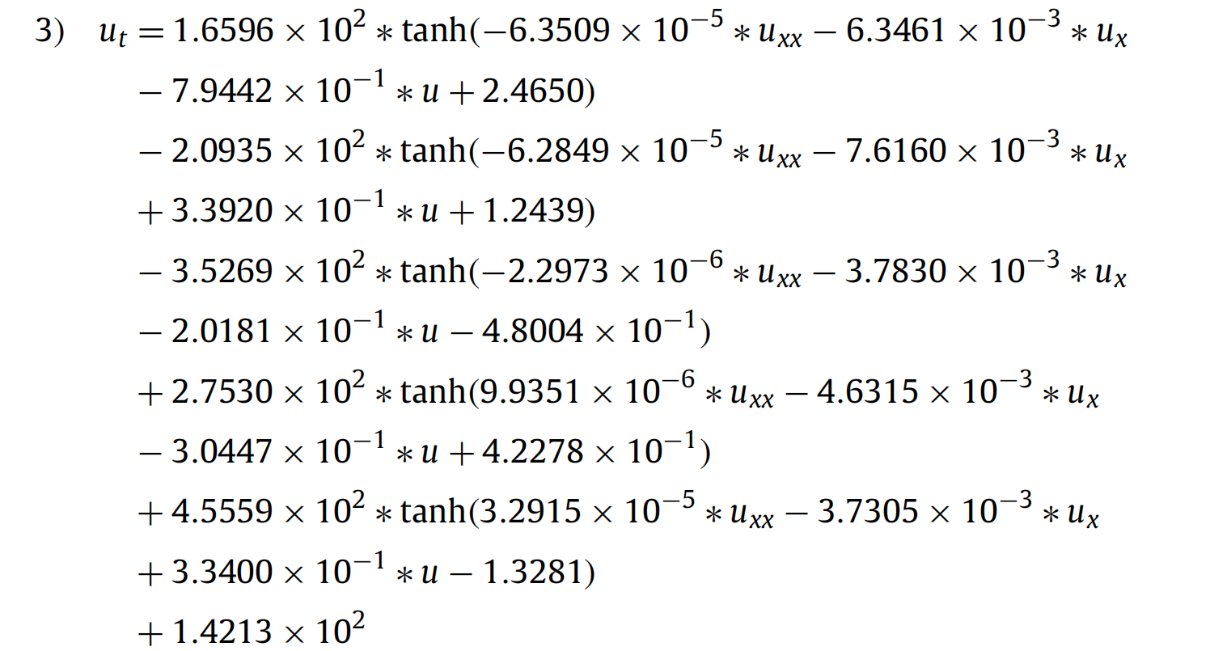
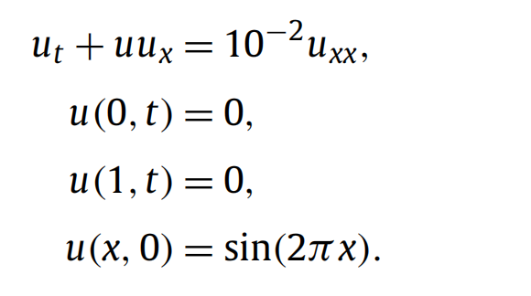
Results – Interesting!!
1) A linear model with the library terms uux and uxx as input features
2) A linear model with up to second order derivative and non-linear terms as input features
3) A single layer feedforward neural network with 5 neurons in the hidden
Origin:

Slide 16
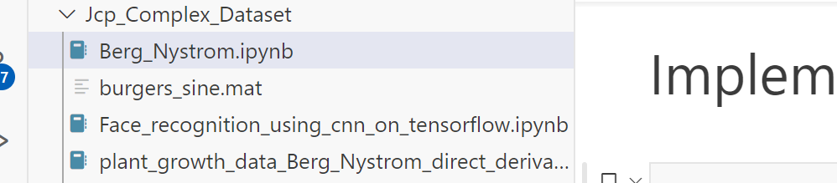
Code
并未完全公开；
缺少数据集Burger_solution.txt！

Slide 17
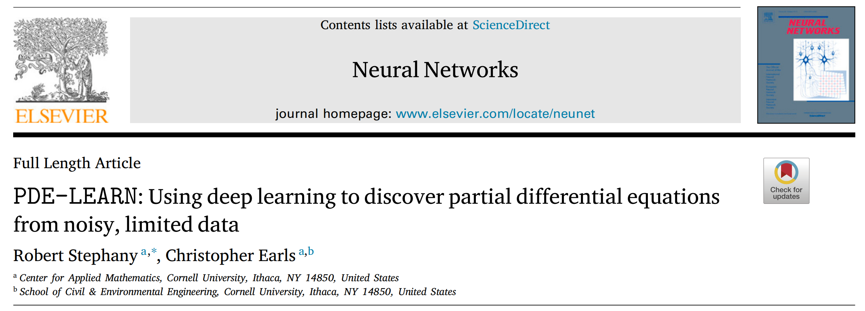
PDE-LEARN: Using deep learning to discover partial differential equations from noisy, limited data

Slide 18
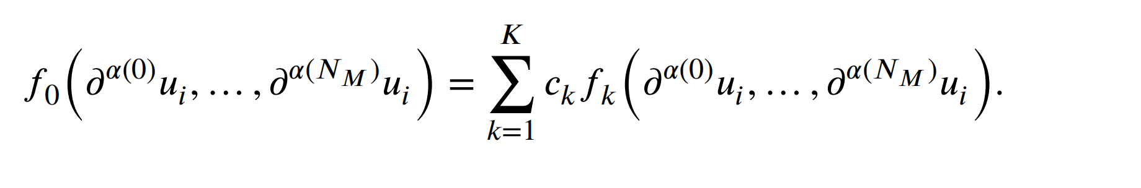
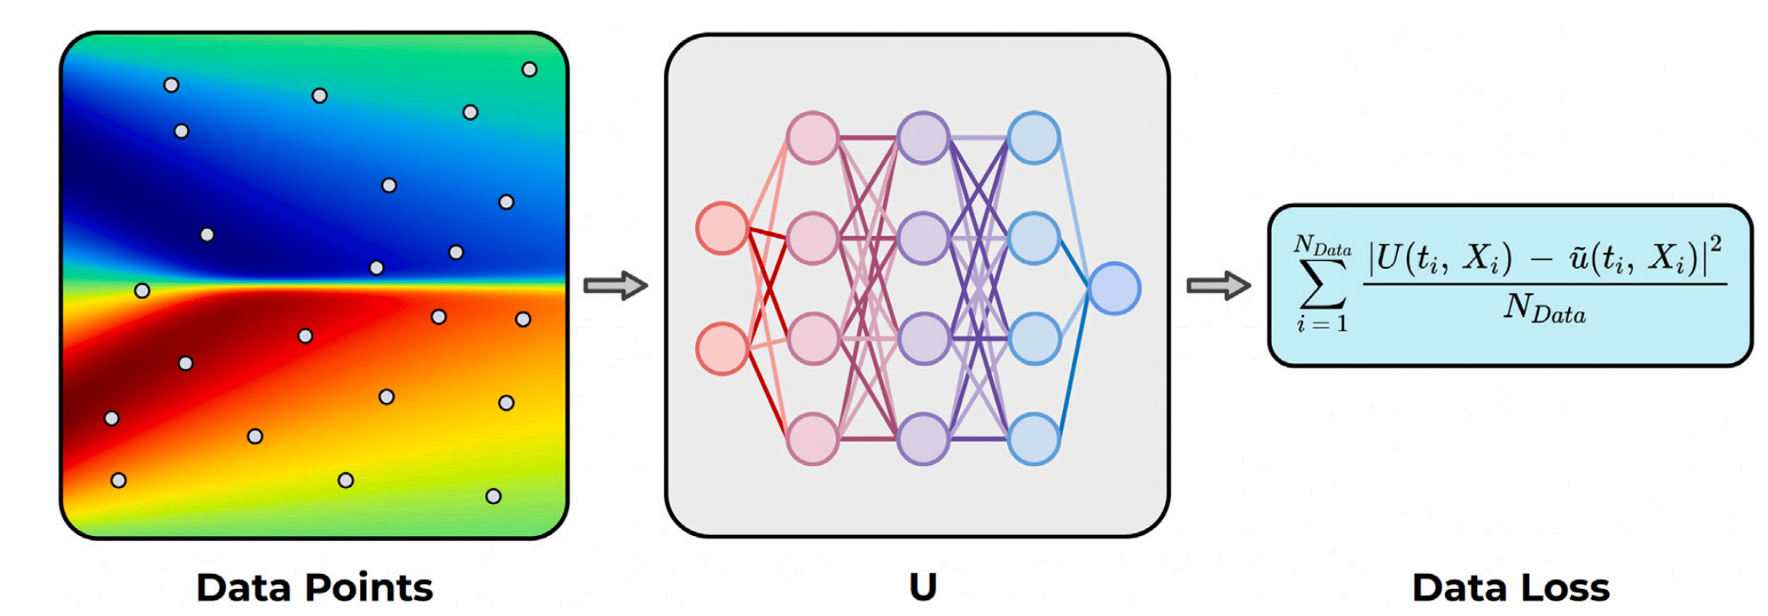
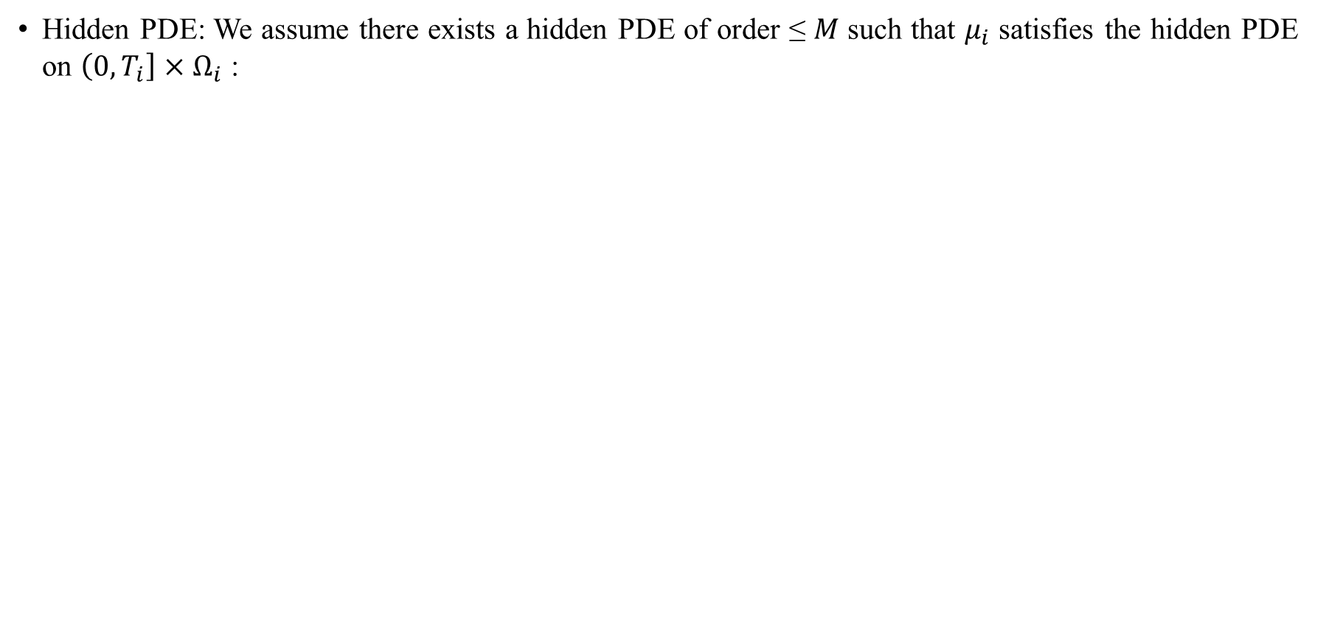
Basic Setting
Hidden PDE: We assume there exists a hidden PDE of order ≤ 𝑀 such that $μ_{i}$ satisfies the hidden PDE on $\left(0,T_{i}\right]×Ω_{i}$ :
left-hand side term
or LHS term
right-hand side term
or LHS term

Slide 19
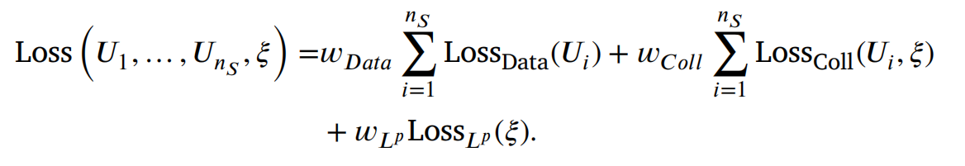
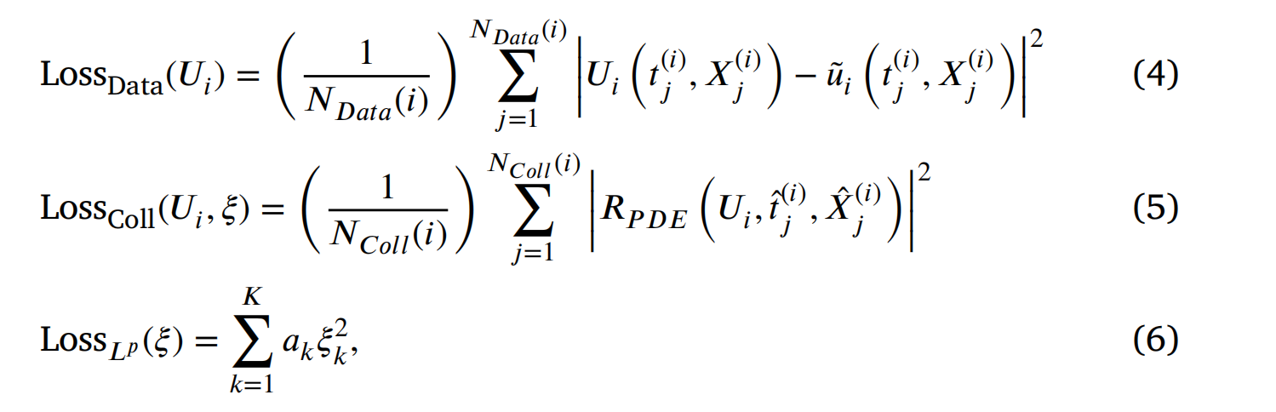
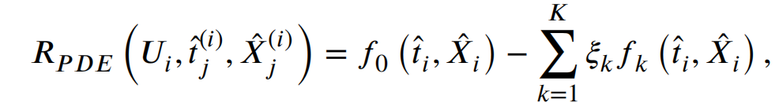
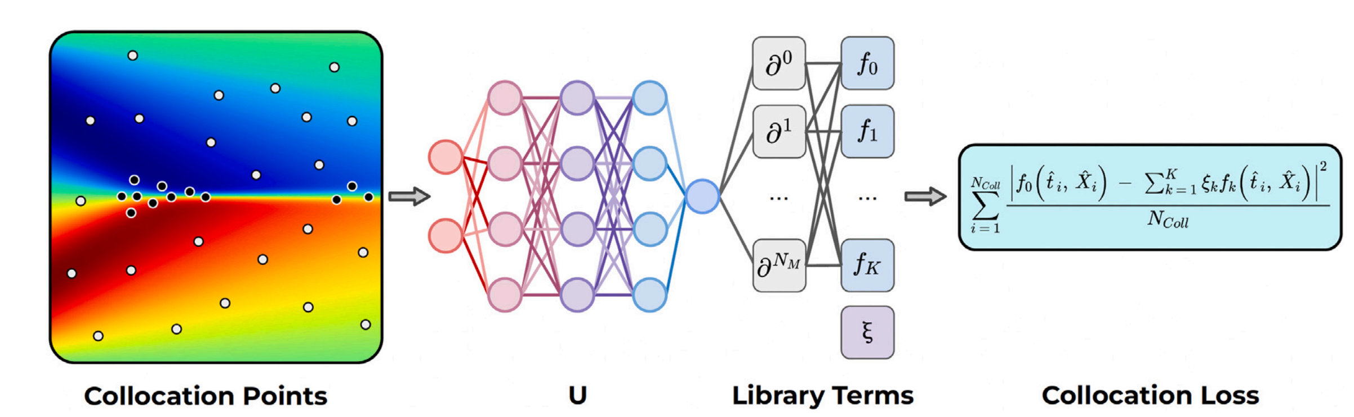
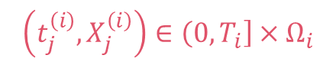
Method
$$\left(t_{j}^{\left(i\right)},X_{j}^{\left(i\right)}\right)∈\left(0,T_{i}\right]×Ω_{i}$$
Data Loss
Collocation Loss

Slide 20


Detail - Candidate Function
$M=2 \& n_{D}=3$:

Slide 21


Codes & Experiments
Dataset: CFD-Bench
1st : Burn-in
2nd : Sparsification:
(D_t U) = - 0.0159(D_x U) + 0.0142(D_x^2 U) + 0.0189(D_x^3 U) - 0.0016(D_x^2 U)*(U) + 0.0201(D_x U)^2*(U) + 0.0186(D_x U)^3*(U)
3rd : Fine-tuning:
Epoch = 200:
(D_t U) = 0.0101(D_x U)^2 - 0.0057(D_x U)^2*(U) - 0.0024(D_x U)^3*(U) + 0.0018(D_y U) + 0.0028(D_y^2 U) + 0.0033(D_y^3 U)

Slide 22
Codes & Experiments
3rd : Fine-tuning:
Epoch = 400:
(D_t U) = 0.0302(D_x U)^2 - 0.0177(D_x U)^2*(U) - 0.0203(D_x U)^3*(U) - 0.0207(D_y U) - 0.0247(D_y^2 U) + 0.0049(D_y^3 U)
Epoch=500:
(D_t U) = - 0.0188(D_x U)^2 - 0.0139(D_x U)^2*(U) - 0.0189(D_x U)^3*(U) + 0.0142(D_y U) + 0.0179(D_y^2 U) + 0.0136(D_y^3 U)

Slide 23

Data-Driven Identification of Parametric Partial Differential Equations
震惊！!
SIAM！
计算数学顶刊！

Slide 24




Basic Settings
1st : Assume a PDE can be written into the form:
2nd : Construct a separate regression for each timestep:
3rd : Solve the above sys.tem using SGTR with columns of the block diagonal library matrix.
What’s the difference between this paper and PDE-Find?
The use of SGTR Algorithm!

Slide 25

Sequential grouped threshold ridge regression (SGTR)

Slide 26


Code
原代码对于Basis function的预处理实在是太强了，用于构造基函数的项与原方程基本保持了一致，因此解出来效果特别好（和PDE-Find没有本质的区别）。

Slide 27

Idea:
关于论文“Data-driven discovery of PDEs in complex datasets”：
第一个怎么解的：“A linear model with the library terms uux and uxx as input features”
第二个怎么解的： “A linear model with up to second order derivative
and non-linear terms as input features”
第三个怎么解的： “A single layer feedforward neural network with 5 neurons in the hidden layer with the hyperbolic tangent activation and up to second order derivative terms as input features”

Slide 28
Idea:
第一个之所以解出来很好，不就是因为basis function处理得好吗？这一步当然，很多论文都做了很多的预处理；
第二个第三个才是正常人的解法逻辑；当然有很多冗余的项；
那么问题来了，我对这些冗余的项做一些特殊的处理，不就可以扔掉了吗？？而无需根据coefficient的大小来扔掉部分项，当然这样也是极其不科学的。

Slide 29


Idea:
首先对每一个发现的方程项都画出图（比如这样）：
对发现的每一项都进行一个equation space的GMM聚类，再观察数据出现在系数偏微分项矩阵的哪些块上。如果有的偏微分矩阵项出现的聚类太少，那么就人工忽略掉；

Slide 30


Idea
Step 1：对于已发现的方程N=f_1+f_2+……+f_K，首先进行GMM聚类，得到Cluster1，Cluster2，……，Cluster6，并且画出每一个Cluster下1得到K个方程项（equation terms）的方差图：
Step 2：使用SPCA算法，对于每一个Cluster i的协方差矩阵进行主成分稀疏化分析，因此一个密集的协方差矩阵就会变得稀疏；

Slide 31


Idea
Step 3：合并主动力项相同的Cluster（Cluster 2 & 5）、删除不包含动力学的Cluster 1，保留原始横轴坐标：
Step 4： 搜索横轴坐标（即f=[f_1,f_2,……,f_K]，应该有K个横轴坐标）中哪些项没有被包含在任何Cluster之中；假设有M个项 f_M=（f_{i_1}, f_{i_2}，……，f_{i_M}）没有被包含，则：
N \times I_K=f\times I_K=[f-f_M] \times I_{K-i_M} ——>The equation we want!
$N×I_{K}=f×I_{K}=\left[f−f_{M}\right]×I_{\{K−i_{M}\}}$

